Slide 1
College Tech Math 1
Significant digits, Precision, Accuracy

Slide 2
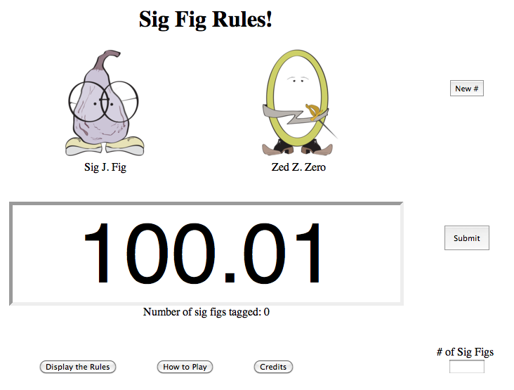
Significant Digits
The accuracy and precision of a measurement is important in real-life calculations. To start our discussion, let’s define a significant digit.
Click here

Slide 3
Accuracy
The accuracy of a measurement refers to the number of significant digits in the measurement.
Determine the accuracy of each value. (Example)
$$a) 14.2$$
$$3 significant digits$$
$$b) 0.02$$
$$1 significant digit$$
$$c) 60,000$$
$$1 significant digit$$
$$d) 7,0\overline{0}0$$
$$3 significant digits$$

Slide 4
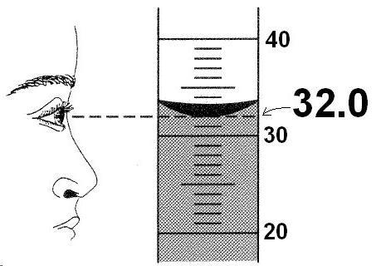
Accuracy
The accuracy of a measurement refers to the number of significant digits in numeric value of the measurement.
Determine the accuracy of each value. (Skill Check)
Click here

Slide 5
Accuracy
When performing a multiplication or division, the accuracy of the product or quotient is defined by the level of accuracy of the numbers involved in the calculation. A product or a quotient will be rounded to contain the same number of significant digits as the least accurate measurement in the calculation.

Slide 6
Accuracy
Complete each calculation. Round to the appropriate number of significant digits. (Example)
$$a) 635 mi ÷8.6 hr$$
$$635 mi ÷8.6 hr=73.8372093 mph$$
$$≈74 mph$$
$$3 significant digits$$
$$2 significant digits$$
$$Quotient should be rounded to 2 significant digits$$

Slide 7
Accuracy
Complete each calculation. Round to the appropriate number of significant digits. (Example)
$$b) 70 mph(8.4 hr)$$
$$70 mph(8.4 hr)=588 mi$$
$$≈600 mi$$
$$1 significant digit$$
$$2 significant digits$$
$$Product should be rounded to 1 significant digit$$

Slide 8
Accuracy
Complete each calculation. Round to the appropriate number of significant digits. (Skill check)
$$a) \left(252 m\right)\left(4.8 m\right)\left(300 m\right) ≈400,000 m^{3}$$
$$b) 56\frac{1}{2}mi÷25mph ≈2.3 h$$

Slide 9
Precision
The precision of a measurement refers to the place value of the right-most significant digit.
Determine the precision of each value. (Example)
$$a) 18 tons$$
$$ton$$
$$b) 4.32 mi$$
$$hundredth of a mi$$
$$c) 40,000 lbs$$
$$ten thousand lbs$$
$$d) 35\frac{2}{5} cm$$
$$one−fifth of a cm$$

Slide 10
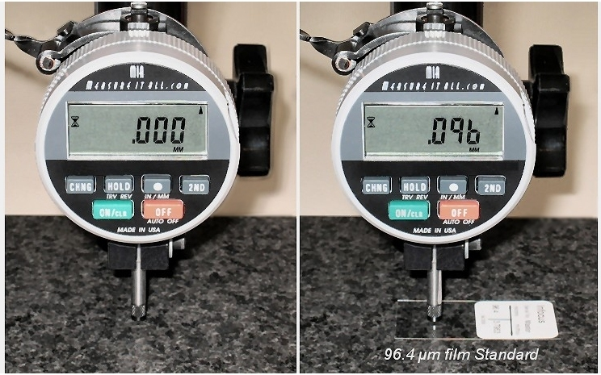
Precision
The precision of a measurement refers to the place value of the right-most significant digit.
Determine the precision of each value. (Example)
Click here

Slide 11
Accuracy
When performing An addition or subtraction, the precision of the sum or difference is defined by the level of precision of the numbers involved in the calculation. A sum or a difference will be rounded to contain the same precision as the least precise value in the calculation.

Slide 12
Precision
Complete each calculation. Round to the appropriate level of precision. (Example)
$$a) 7.46 m+3.1 m+11.95 m$$
$$7.46 m+3.1 m+11.95 m=22.51 m$$
$$≈22.5 m$$
$$hundredth of a m$$
$$tenth of a m$$
$$hundredth of a m$$
$$Sum should be rounded to the tenth of a m$$

Slide 13
Precision
Complete each calculation. Round to the appropriate level of precision. (Example)
$$b) 50 ft+9. 8 ft+63.5 ft$$
$$50 ft+9.8 ft+63 ft=122.8 ft$$
$$≈120 ft$$
$$ten ft$$
$$tenth of a ft$$
$$ft$$
$$Sum should be rounded to the ten ft$$

Slide 14
Precision
Complete each calculation. Round to the appropriate level of precision. (Skill Check)
$$a) 173 cm+95 cm+12.6 cm ≈280 cm$$
$$b) 0.003 mm+0.045 mm+0.017 mm ≈.07 mm$$

Slide 15
Greatest Possible Error
The greatest possible error of a measurement is ½ of the precision of the measurement.
Determine the greatest possible error for each measurement. (Example)
$$a) 42 ft$$
$$Precision: 1 ft$$
$$Greatest possible error: \left(1 ft\right)\left(\frac{1}{2}\right)=\frac{1}{2}ft$$

Slide 16
Greatest Possible Error
The greatest possible error of a measurement is ½ of the precision of the measurement.
Determine the greatest possible error for each measurement. (Example)
$$b) 3.24 mm$$
$$Precision: 0.01 mm$$
$$Greatest possible error: \left(0.01 mm\right)\left(\frac{1}{2}\right)=0.005 mm$$

Slide 17
Greatest Possible Error
The greatest possible error of a measurement is ½ of the precision of the measurement.
Determine the greatest possible error for each measurement. (Example)
$$c) 23\frac{2}{5} in$$
$$Precision: \frac{1}{5} in$$
$$Greatest possible error: \left(\frac{1}{5}in\right)\left(\frac{1}{2}\right)=\frac{1}{10} in$$

Slide 18
Greatest Possible Error
Determine the greatest possible error for each measurement. (Skill Check)
$$a) 24 mi$$
$$0.5 mi$$
$$b) 300 in$$
$$50 in$$
$$c) 1.43 ft$$
$$0.005 ft$$
$$d) 56\frac{3}{4} cm$$
$$\frac{1}{8} in$$

